Slide 1
Ayurveda
*Please note: The information provided herein this presentation is for educational purposes and is not intended to prescribe, treat, or diagnose, or provide medical advice for any treatment or disease. See a qualified medical doctor for any health problem. If you decide to try any of the following practices or procedures, you are responsible for the outcome.
The Science of Life
Goal: “ To conserve, protect, and maintain the health of the healthy and resolve/relieve the illness of the diseased”
Ayur = Life
Veda = Wisdom, Knowledge, Science

Slide 2
What is Health? What is Disease?

Slide 3
Origins of Ayurveda
3000-1000 BC
• Vedic Culture migrated from Indus Valley
• Brought the “Vedas” –4 Books
(Rig Veda, Yajur Veda, Sāma Veda, Artharva Veda)
health, healthcare techniques, astrology, spirituality, prayer, government, politics, art, and human behavior
1000-700 BC
• Organized into 3 main texts
- Caraka Samhita – 120 chapters - 8,400 verses
textbook internal medicine, basic concepts
- Sushruta Samhita - surgical text
surgical instruments & procedures
107 marma points, blood
- Asthanga Hridaya – 8 branches (550-600 AD)
very concise and written in verse
compiles wisdom from previous texts
Scholars date Ayurveda to be 3,000-5,000 years old.

Slide 4
8 Branches of Ayurvedic Medicine
Internal Medicine
Prevention, cause, prognosis, management
Pediatrics
Prenatal, postnatal, care before conception, various childhood diseases
Science of Rejuvenation
Prevent disease, promote healthy living, strengthen body after disease
Surgery
1st plastic surgeries described, surgical tools and techniques
Ear, Nose, Throat, Eye Diseases
Toxicology
Toxicity and purification of herbs, minerals, animal products
Psychology
Mental diseases, treatment with diet, herbs, yoga
Science of Aphrodisiacs
Increase sexual vitality and potency, create healthy, intelligent children

Slide 5
What is Health?
Health
Swastha: Established in the Self - A state of complete physical, sensory, mental and spiritual wellbeing
“A person who has optimal musculature and build, whose senses are sharp and receptive, one who is able to withstand sickness with ease, who can tolerate hunger, thirst, excessive sun, cold, exercise, whose food digests and assimilates optimally and who develops optimal physical statue.”
“A person whose dosha (energy), agni (digestive fires), dhatus (tissues) and malas (waste products) are in balance and whose atma (soul), mana (mind) and indriya (senses) are in a lucid, pure, and pleasant state.”

Slide 6
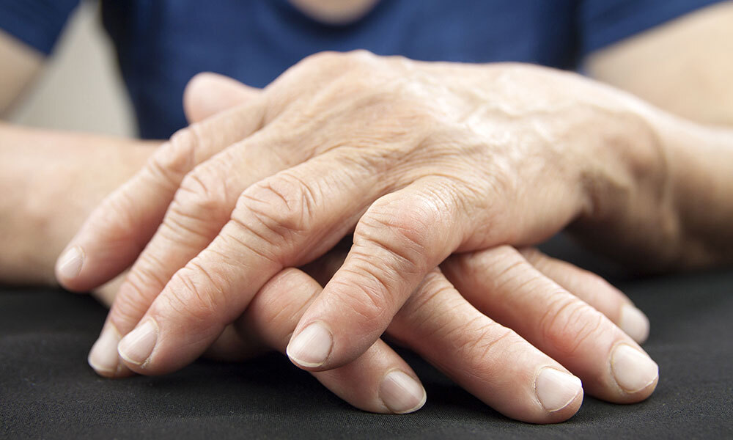
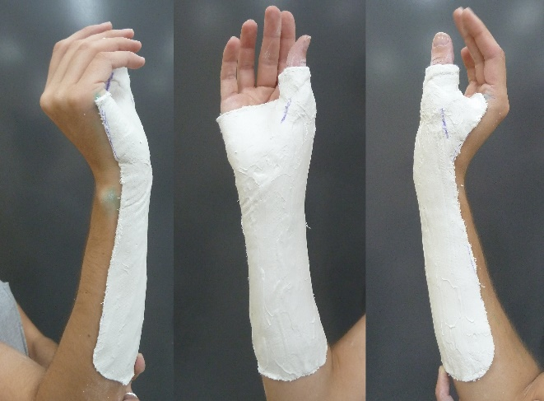
What is Disease?
“Tat dukkha sanyoga vyadhaya uchanta”
Suffering by any means is Disease
Not limited to physical pain
Includes mental agonies + disturbances
Diseases are the outcome of dhatu imbalance
Dhatu = tissues
(rasa, rakta, mamsa, meda, asthi, majja, shukra)
Diseases are the outcome of dosha imbalance
Dosha = vata, pitta, kapha

Slide 7
What Makes Ayurveda Special?
Ayurveda is a reflection of Nature
We are a part of Nature
Believes all people are unique
Considers all level of the individual: spiritual, emotional, intellectual, behavioral, physical, family relationships, social, environmental and universal
Offers natural ways to treat disease and promote health with emphasis on prevention
Empowers people to be responsible for their own well-being
It works and is cost effective
Nature is Cyclic:
seasons, life cycles, night/day
When we…
Live in balance with nature = health
Live in discord with nature = disease
Ayurveda uses an individualized and multi-dimensional approach for prevention and treatment of disease
Ayurvedic healing incorporates healing all aspects of ourselves, mentally, spiritually, emotionally, and physically.

Slide 8
Improper use of Senses
Asātmendriyārta samyoga
Atiyoga: Excessive use of senses – excessive screen time
Hinayoga: Lack of use of senses – reading in poor light or while lying down
Transgression of Wisdom
Pragnyāparadha
“crimes against intelligence”
Pragna: highest form of intellect, Manifests in 3 forms: dhi, dhriti, smriti
Dhi: grasp of knowledge – correct discretion between good and bad, what is transient and permanent, perceiving a proper balance between both.
Effect of Time
Kala
One must consciously form a creation, however only time is enough to cause degradation.
Mithyayoga: Altered use of senses – not using the eyes to see
Dhriti: control over execution – it is difficult for the mind to withhold from sensory indulgence when engrossed in enjoying sense pleasures.
Smriti: awareness & remembrance of Self – when a soul is clouded by rajas and tamas it forgets its true nature and calling. Lapse in memory and awareness leads to internal conflict.
The time effect of season, age and transitional periods like puberty, pregnancy, menopause all effect the disease state.
Extremes in weather or altered seasonal patterns can cause disease.
Diseases transition through different stages at different times during their development. Such as states of ama, nirama, dosha shaman and rasāyana.
Nidana
Cause of Disease
3 Main
Causes of Disease Nidana

Slide 9
20 Qualities and the 5 Elements
Space/Ether (Akasha)
Subtle, Soft, Clear, Smooth, Expanding
Quality: non-resistance Sense: Sound
Air (Vayu)
Rough, Dry, Light, Cold, Mobile
Quality: movement Sense: Touch
Fire (Tejas)
Hot, Sharp
Quality: Conversion, Illumination Sense: Sight
Water (Aap)
Flowing, Wet, Dull, Soft, Cloudy
Quality: Cohesion Sense: Taste
Earth (Prithi)
Gross, Heavy, Static, Hard, Dense
Quality: Stability Sense: Smell
Heavy | Light
Cold | Hot
Oily | Dry
Dull | Sharp
Smooth | Rough
Dense | Liquid
Soft | Hard
Static | Mobile
Gross | Subtle
Cloudy | Clear

Slide 10
3 Doshas – 3 Dynamic Energies that Influence Nature
Kapha (water + earth)
2/3 earth/body is water
Pitta (fire + water)
Heat and Transformative energy
Vata (space + air)
Moist, cold, heavy, static, sticky, cloudy, slow, smooth, dull
Location: head, stomach, lungs, lymphatic, mucus, joints, mouth, brain, crebro-spinal fluid
Subtle: forgiveness, love, compassion, calmness, happiness, contentment
Function: supports, lubricates, moistens, strengthens, stamina
Oily, sharp, hot, light, moving, spreading, liquid, acidic smell
Location: sm intestine, lower stomach, blood, sweat glands, skin, eyes, liver, spleen, pancreas
Function: digestion, assimilation, absorption, transformation, body temp, skin luster, thirst, vision
Subtle: discrimination, intelligence, leadership, clarity of speech, boldness
Movement, Action, Circulation, Transportation
Transformation, Conversion, digestion, Metabolism
Lubrication, Cohesion, Nourishment
• King of Doshas: pushes kapha and
Pitta
• Dry, light, cold, rough, subtle, mobile
• Location: Abdominal cavity below
umbilicus, colon, pelvis, pelvic
organs, thigh, legs, skin, ears, brain,
nervous system
• Function: all movement of body and
mind, voluntary and involuntary
actions, breathing, removal of
wastes, speech, pumping of heart

Slide 11
Characteristics
Vata
Petite body with small and delicate bones and joints
Variable body proportions or features
Hair and body is thin, dry and rough
Creative, enjoy movement
Always busy, talkative, on the move
Unsteady in thinking, memory, friendships
Easily changes ones mind
Walking is unsteady and fast
Poor sleep
Variable digestion, lower digestive strength
Dislike cold things and environments
Prone to anxiety, worry, fear
Space & Air
Dry, light, cold, rough, subtle, mobile

Slide 12
Characteristics
Medium build, Muscular
Sharp features
Deep set, intense eyes
Skin and complexion is fair and warm, freckles, moles
Flushed hands and face
Less hair, early graying
Brave and Proud
Enjoys athletics and competitions
Sensitive
Prone to frustration, anger, impatience
Pitta
Fire & Water
Oily, sharp, hot, light, moving, spreading, liquid, acidic smell

Slide 13
Characteristics
Kapha
Water & Earth
Gentle natured
Strong, well lubricated joints
Large bones and joints
Thick skin
Short neck
Highly intelligent, truthful and noble
Steady nature
Slow to get started, but have inertia
Good endurance
Prone to jealousy, possessiveness
Moist, cool, heavy, static, sticky, soft, cloudy, slow, smooth, dull

Slide 14
verse
Prakruti (constitution)
Vikruti (current imbalance)
Elemental balance at birth
Does not change during life
General psychological, emotional, and physical tendencies
Physical make up – bone/joint size, skin thickness, etc.
Single Dosha: Vata, Pitta, Kapha
Double dosha: VP, VK, PK
Tridoshic: VPK
People have all doshas/energies present in body – looking for most predominant energies
Current Condition – elements that are currently out of balance
Guides the healing protocol, with respect to prakruti
Vikruti is treated first – then work on balancing prakruti
Can have 1 dosha involved: Vata, Pitta, or Kapha
Can have 2 dosha involved: VP, PK, or VK
Can have all 3 doshas involved V, P, and K
Doshas can mask other doshas, ex: hives – Kapha is masking/covering Pitta

Slide 15
2 pm
6 pm
10 pm
2 am
6 am
10 am
Daily Cycle of the Doshas
Pitta
Kapha
is the
beginning of a cycle
Pitta
is the
middle of a cycle
Vata
is the
end of a cycle
Kapha
Vata
The Life cycle and the Doshas
Kapha
Birth to Puberty
Kapha predominates during childhood
Pitta
Puberty to Menopause
Pitta predominates in midlife
Vata
Menopause to Old Age
Vata predominated during old age
Vata
Kapha
Pitta

Slide 16
Effects of Season on Doshic Energy
Vata late summer - early winter
Kapha late winter – early spring
Pitta late spring - summer
Heat and dryness of late summer triggers pitta aggravation.
Heat of spring and summer melts
accumulated kapha causing
overflow & aggravation.
The cool, dry environment causes vata to
accumulate.
Heat & dryness causes vata to Subside.
Heat of spring and summer triggers Pitta to accumulate.
Dry, cool, wind
of Fall and causes kapha to subside.
Kapha solidifies
& accumulates in
a wet, cold & stagnant
environment prevalent in
late winter and early spring.
Cold rain & snow of winter triggers vata aggravation
Pitta starts to subside
with the cold, wet nature of winter

Slide 17
Energy, Transformation, Metabolism
Agni
Fire
Transforms food that we eat into elements the body can use to make new tissues
Agni is the fire element in the body
Governs our life force, strength, general health, energy levels, radiance of our skin, hormones, ojas
Well balanced Agni = Good health
Deranged Agni = Disease
When agni dies, we die
gives clarity to the mind, thoughts and ideas, digests thoughts and emotions
protects body against microorganisms
separates the nutrients from the waste in the digestive process with samana vayu
Hot, dry, light, subtle, sharp

Slide 18
Status of your Agni
Qualities of Agni: hot, dry, light, subtle, sharp
Sama Agni
Digests food well when eaten in correct amounts
Builds healthy, balanced tissues
Manda Agni
Cooking food on low, takes a long time to cook
Vishma Agni
Cooking food on high, then low
Food does not always cook completely
Food takes a long time to digest – may not digest completely
Forms more dhatu but of poor quality
Heaviness, Lethargy
Dull mind
Gas, constipation
White coating on tongue
Excessive saliva in mouth
Food digests in a timely manner
Lightness
Clear, sharp mind
Tongue is clear
Sometimes Agni is Strong, sometimes Weak
Appetite varies
Forms variable tissues
Cooking food on high
Digests food very quickly
Sour Belching
Food burns on the bottom, but may not cook on top
Can digest food in large quantities or taken infrequently
If too little food: irritates digestive track – burns tissues
Constipation, bloating, gurgling in abdomen
Pain in lower abdomen, back, sides
Prickling pain in the body
Vomiting green, strong acidic smell
Burning pain in the chest and throat
Clear bowel movement
Feeling energetic
Feel hungry at meal times
Balanced
Weak
Variable
Sharp
Tikshna Agni

Slide 19
The Digestive Process
Starts in the kitchen with cooking your food
Gross Digestion
Occurs in the physical digestive system
Subtle Digestion
Occurs after gross digestion
Ahara rasa is converted by Bhutagnis (elemental fires) and Dhatu agnis (tissue fires) into tissues and waste products to be eliminated
Food travels from the mouth, into the stomach, through the small intestine to the large intestine and out the Anus
Ahara rasa (refined nutrients) is transported to the liver by samana vayu
Jatharagni (main digestive fire)
Refined Nutrients (ahara rasa) gets separated from waste materials
Bhutagni and Dhatu agni
①
②

Slide 20
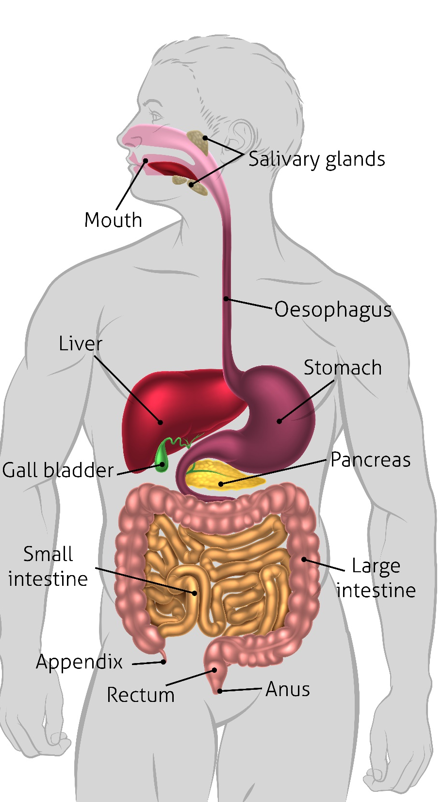
Gross Digestion
Sweet
Food mixes with saliva (bodhaka kapha), Prana Vayu brings food to stomach
Sour
Lower part of Stomach and Small Intestine – digests Sour, Pungent and Bitter
Pungent Astringent
Large Intestine
Space and Air elements are extracted and digested
Sweet food is digested 1st, Earth and Water elements are digested/extracted.
Signs of imbalance: Nausea, Excessive Mucus, and Weight Gain
Process: 1.5-2 hours
Signs of imbalance: Hyperacidity, Heartburn, Ulcers, Infections
Mixes with digestive enzymes (pachaka pitta) including Bile & Pancreatic secretions
Process: 2-3 hours - digestion is prolonged if too much sour, salty and pungent
Process: 1.5-2 hours
Signs of imbalance: Distension, gas, Constipation and Dryness in body
❶
❷
❸

Slide 21
Ama (undigested food or metabolic toxins)
Ama Accumulation
10 Symptoms of Ama
Imbalanced Agni
Incomplete digestion of Food
Accumulation of Ama
Clogging of the channels (sinus congestion, constipation, lymph congestion)
Fatigue
Heaviness
Abnormal flow of vata (excessive upward or downward moving energy – heartburn, constipation)
Indigestion
Stagnation
Excessive Salivation
Mental Fatigue
Laziness/Lethargy
Loss of interest in Food

Slide 22
Ama or Nirama (imbalance with ama or imbalance without ama)
Vata
Sāma vata – Vata mixed with ama (space and air elements mixed with toxins)
Constipation, reduced agni, excessive sleepiness, growling in the stomach, pain in the pelvis, edema, prickling pain in the body.
Nirama vata – Vata imbalance with NO ama
Clear, dry, unobstructed with less pain. It diminishes rapidly with oleation.
Pitta
Sama pitta – Pitta mixed with ama (fire and water element mixed with toxins)
Foul smelling, green, slightly black, sour, stable, heavy, sour biliary belching, burning in heart and throat.
Nirama pitta – Pitta imbalance with NO associated ama
Excessively hot, sharp, bitter taste, unstable, without foul smell, accompanied with good agni, bala and appetite
Kapha
Sama Kapha – Kapha mixed with ama (water and earth mixed with toxins)
Constipation, reduced agni, excessive sleepiness, growling in the stomach, pain in the pelvis, edema, prickling pain in the body.
Excess kapha is always associated with ama – has the same qualities.
Purisha
Sama purisha – Ama (toxins) mixed with fecal matter
One that sinks in water, foul smelling, very sticky, not well formed, comes out in small frequent quantities
Nirama purisha – No ama is mixed with fecal matter
Bowel movement comes easily , after waking every day, no foul smell, floats, is well formed, not sticky.
(fecal matter)

Slide 23
7 Dhatus (tissues) 3 Malas (waste products)
❶
Rasa (plasma)
Asthi (bone)
Majja (nerve)
Shukra reproductive
Mamsa (muscle)
Meda (fat)
Breast milk, menstrual fluid Mala: Kapha
Rakta (blood)
Plasma, Lymph, Serum – nourishes all tissues
Blood - Life giving – carries prana
Tendons, blood vessels Mala: Pitta
Muscle – plastering/ protection of body
Subcutaneous fat, skin Mala: natural orifices
Fat – Lubrication
Ligaments Mala: Sweat
Bone – support, supporting the organs
Teeth Mala: Hair, nails
Bone Marrow, Nervous System – filling feeling
Tears Mala: Oiliness in eyes, skin, feces
Reproductive Fluids – procreation
“That which Spoils or Decays”
3 waste channels
❷
Mutra (urine)
Maintains moistness in body
Purisha (feces)
Removes solid wastes from body
Sweda (sweat)
Keeps skin moist, prevents cracking and drying
Removes waters, salts, minerals
Maintains fluid balance, thereby controls blood pressure
Supports intestinal walls
Removes toxins from intestinal tract
Slows down emptying
Maintains body temperature
Cleanses the toxins from the skin
❸
❹
❺
❻
❼
Ojas fluid of Life
Produced at every stage of digestion – finest, most refined end product – brings zest for life
Sweet, cold, oily, stable, smooth, heavy, dull, gross, slimy, clear – vigor, strength, immunity

Slide 24
6 Stages of Disease Shat kriya kala
Fist 3 stages are Preventative (1-3)
Last 3 stages are Curative (4-6)
Accumulation
Dosha accumulates at its home base (stomach, sm intestine, colon
Pitta: yellowish skin, things look yellow
Aggravation
Further increase causes dosha to overflow home base, Ama mixes with aggravated dosha = samadosha (ama + dosha)
Spread Circulation
Aggravated dosha start flowing all over body, samadosha blocks or creates weakness in weakest tissue – Disease process starts here
Vata: gas, bloating, distension
Kapha: heaviness, lethargy, loss of appetite, feeling cold
Kapha: Nausea, aversion to food
Vata: pricking pain, movement of gases in colon, intense desire for coldness
Pitta: sour belching, thirst, burning in stomach
Vata: intense movement of gas, gas can move upward, body becomes stiff
Pitta: intense thirst, dry mouth, inflammation of mucus membranes in mouth, burning sensation in body
Kapha: increased nausea, vomiting, excessive salivation, loss of taste
Localization Fixation
Dosha finds a weak tissue and mix/react with it
Ama combined with dosha and dhatu create a biochemical compound
Manifestation
“Classical” manifestation of disease
Disease may be difficult to treat at this stage
Differentiation Change Alteration
Disease can change even after fully manifested, goes through different doshic phases
Tissues loose their intelligence and integrity
Ex: diarrhea, piercing pain, diabetes, kidney disorder, dysuria, hemorrhoids, fistula, fissure, headaches, sinusitis, disease of sense organs, skin diseases, pain
Disease is given a name in western medicine
Disease has manifested and is deeply routed in the tissues, ex: diabetes
Vata Arthritis: severe pain, coldness, stiffness with dry skin and constipation
Pitta Arthritis: fever, burning sensations, red swollen joints and loose motions
Kapha Arthritis: swelling, edema, phlegm and congestion
❶
❹
Body craves balance – desires foods of opposite qualities
Must be treated through cleansing (shodana) techniques and herbs
❷
❺
Must be treated through cleansing (shodana) techniques and herbs
Samadosha removed by cleansing: vomiting, purgation, enema
❻
❸
Must be treated through cleansing (shodana) techniques and herbs
Doshas are removed by cleansing and/or balanced with counteracting herbs

Slide 25
Nidana Panchana: 5 Steps to Understand the Nature of Disease
1. Nidana
cause
Cause that is responsible for doshic imbalance or symptoms
Important if disease is acute or chronic
2. Purvaroopa
warning signs
Symptoms or pre stages of disease – can be warning signs
If imbalance is corrected – disease progression can be halted
3. Roopa
manifestations
Cardinal signs of disease as described in Ayurvedic texts
Ex: Increase heat is the roopa of fever, body aches are purvaroopa.
1st step of treatment - Nidana parivarjana – avoid the cause
Example: Burning of the eyes before a fever
All specific signs of disease must be present for diagnosis
4. Upashaya
treatment response
5. Samprapti
pathology
Something that makes someone feel better
Medicines, diets, and regiments that reduce suffering
Ex: If joint pain is aggravated by heat and oil application, it is amavata (rheumatoid arthritis) not degenerative osteoarthritis.
Ayurvedic pathology of disease
How the causes triggered imbalance responsible for the current disease – from cause to vitiation of doshas and dhatus to disease
Classified further by specific characteristics, dosha dominance, ext.

Slide 26
Disease Classifications
Dosha involvement (80 vata, 40 pitta, 20 kapha)
How easily curable (easy, difficult, manageable but not curable, incurable)
Mild or Severe
Psychological or Physical
Internal (dosha, dhatu, mala) or External (trauma, environmental hazards/pollution)
Diseases that arise from the stomach or the colon
Treatable with medicine (herbs, oleation, panchakarma) or Surgery (appendicitis)
Genetic (improper lifestyle of mother during pregnancy) or from wrong doings in past or present lifetimes
Physical cause / External trauma 9animal attach, weapon)
Caused by nature (seasonal change, natural disaster, age related disease
Over Nourishment or Undernourishment
Mass level epidemics

Slide 27
80 Diseases Caused by Vata
1. Cracking of nails | 17. Pain in scrotum | 33. Stiffness of penis | 49.Inability to talk clearly | 65. Facial paralysis
2. Cracking of feet | 18. Tightness of pelvis | 34. Stabbing pain chest | 50. Astringent taste mouth | 66. Hemiplegia
3. Pain in foot | 19. Pain in pelvis | 35. Atrophy of arm | 51. Dryness of mouth | 67. Convulsions
4. Foot drop | 20. Diarrhea | 36. Stiffness of neck | 52. Inability to taste clearly | 68. Fainting
5. Numbness of foot | 21. Bloating | 37. Hoarseness of voice | 53. Ear ache | 69. Tremor
6. Clubbed foot/clubbed digits | 22. Bloating – vata, moves wrong way | 38. Stiffness of cervical spine and trapezius | 54. Reduced sense of hearing | 70. Headache – chronic
7. Stiffness in ankle | 23. Kyphosis | 39. Pain in jaw | 55. Complete deafness | 71. Yawning
8. Cramps in calves | 24. Dwarfism | 40. Pain in lips | 56. Ptosis of eye lid | 72. Hiccup
9. Sciatica | 25. Pain in flanks | 41. Toothache | 57. Retraction of eyelid | 73. Depression
10.Slitting pain in knee joint | 26. Stiffness of sacro-iliac joint | 42. Reduced or complete loss of smell | 58. Displacement of eyebrow | 74. Excessive irrelevant talk
11. Knock knee | 27. Stiffness of back | 43. Looseness of tooth | 59. Loss of vision | 75. Dryness
12. Dysfunction of thigh or rigid thigh | 28. Gripping pain in abdomen | 44. Ringing or other sounds in the ear | 60. Diseases affecting the entire body | 76. Giddiness, dizziness
13. Lack of strength and pain in thigh | 29. Reduced heart rate – due to weakness | 45.Displacement / lack of eye functioning | 61. Chronic convulsions, with spastic tightness | 77. Dark purple discoloration
14. Paraplegia | 30. Tachycardia | 46.Speech dysfunction | 62. Pain in eye | 78. Roughness
15. Prolapsed rectum | 31. Pain in Chest | 47.Dandruff | 63. Pain in forehead | 79. Insomnia
16. Tenesmus: urge to pass stool, frequent | 32. Impairment of thoracic movement | 48. Diseases affecting one part of the body | 64. Pain in temporal region – sharp, cutting | 80. Instability of mind

Slide 28
40 Disease caused by Pitta
1. Sensations of heat | 9. Increased body heat | 17. Cracking of skin | 25. Bluishness, jaundice | 33. Pharyngitis
2. Sensations of scorching | 10. Excessive sweating | 18. Urticaria | 26. Herpes | 34. Conjunctivitis
3. Sensations of burning | 11. Bad odor in body | 19. Red vesicle | 27. Jaundice | 35. Inflammation anus
4. Sensations of boiling | 12. Sharp pain in the body | 20. Bleeding tendencies | 28. Bitter taste in the mouth | 36. Inflammation of the penis
5. Sensations of fuming | 13. Sloughing of blood | 21. Red wheals | 29. Fetid odor mouth | 37. Hemorrhage
6. Acid reflux | 14.Flaking of the skin | 22. Greenish color | 30. Excessive thirst | 38. Blacking out
7. Heartburn | 15. Sloughing of muscle | 23. Yellowish color | 31.Stomatits | 39. Not feeling full
8. Burning sensations inside the body | 16. Burning sensations in the shoulder | 24. Burning sensation in skin | 32. Smell of blood in the mouth | 40. Green/yellowish color eyes, urine, feces
20 Diseases caused by Kapha
1. Lingering fullness | 5. Heaviness of body | 9. Mucus expectoration | 13. Plaques in the heart | 17. Coldness of limbs
2. Drowsiness | 6. Laziness | 10. Excessive feces | 14. Goiter | 18. Hives
3. Excessive sleep | 7. Sweet taste in mouth | 11. Indigestion | 15. Obesity | 19. Salivation
4. Lethargy | 8. Hardening of vessels | 12. Loss of strength, ex: plaque in arteries | 16. Phlegm adhered to the throat | 20. White urine, eyes, face – frothy urine

Slide 29
Ayurvedic Consultation
3 Fold Assessment
10 Point Examination
8 Part Examination
Vikriti: doshic imbalance
Desha: place of living
Bala/Sara/ Vyama Shakti: strength of tissues/ nourishment of tissues/ exercise tolerance
Kala: time, cycles of time, stage of life
Agni: ability to digest
Prakriti: doshic balance at birth
Vaya: age
Sattva: nature of mind
Satmya/ Astmya: habitual habits
Ahara: Food, meal patterns
Pulse: rate, rhythm, volume, amplitude, fullness, temperature, palpation on pressure
Urine: frequency, quantity, color, odor, texture, feeling, discharge
Stool: Consistency, with effort, complete evacuation, sink/float, sticky
Tongue: coating, color, cracks, bumps, quivering, odor
Voice: coarse, inconsistent, sharp, penetrating, loud, clear, resonant
Skin: dry, rough, cold, warm, discolored, flushed, sensitive, thick
Eyes: dry, cloudy, sharp, penetrating, sensitive, oily, soft
Body Structure: erect, large, average, petite, bony, muscular
Observation: state of health, build, mass, weight distribution, hair, skin, nails, tongue, gait
Touch: temperature, dryness of skin hair nails, palpitation, tenderness, pulse
Inquiry: history, tendencies, physiological tendencies, nature of environment, diet, lifestyle, life attitude, what makes someone happy?

Slide 30
Creating a healing protocol (Chikitsa)
Diagnosis (Samprapti)
Treatment (Chikitsa)
Determine Nidana – root cause
Determine Vikruti (current doshic imbalance) and Prakruti (doshic balance at birth)
Discover the State of the clients Agni
How much Ama? (Ama or Nirama state)
What Srotas, Dhatus, and Malas (waste products – stool, urine, sweat) are involved?
Determine state of Ojas
Disease (vyadhi) – sufferings client has
Eliminate Nidana or root cause for imbalance or causative factors of the disease
Correct Agni and Burn Ama (Agni deepana and ama pachana)
Correct doshic imbalances (vikruti) with consideration to genetic constitution (prakruti)
Address tissue (srotas/dhatu) involvement – nurture or cleanse involved tissues through herbs and panchakarma (unique Ayurvedic cleansing techniques).
Suggest healing herbs, diet, and lifestyle that will support agni, ama, dosha, dhatu, manas (mind), atma (spirit), ojas and help balance sensory input.

Slide 31
How to Empower the Healer Within - The 4 Inputs that influence your health
When to Eat?
• Most important
• Only when hungry
• Follow regular meal times, same time every day
• Breakfast 7-7:30, Lunch 11-1, Dinner 6-7:30
• Some do well with 2 meals a day (morning and evening)
• Leave 4-5 hours between meals
• Do not shower, sleep/nap, or exercise directly after eating
• Avoid incompatible food combinations
What to Eat?
• Warm cooked food - reduce raw, cold foods
• Non processed, whole grain diet – Reduce processed, canned and left over foods.
• Fresh seasonal vegetables and fruits
• Organic food – meat & dairy
• Eat foods with balancing qualities for Vikruti (current doshic imbalance) with consideration to you Prakruti.
• No: chemicals, additives, food colorings, Microwaved or Genetically modified foods
How Much?
• Feel satisfied but not heavy
• Should be able to breathe, talk and walk easily
• Senses are sharp
• 1/3 solid food, 1/3 fluids, leave 1/3 for air.
• 1 Anjali (2 hand cup) of raw grains
• Too much food – lowers agni – incomplete digestion – formation of ama (toxins)
•Too little food – depletion, burning up of dhatus (tissues) and srotas (channels)
Food
Breath
Breath and mind are connected
Water
6-8 cups per day (drink warm water – above room temp)
Revitalizes the body, steadies the emotions, clears the mind
Types: Nadi Shodhana, Sheetali, Bhastika, Diaphragmatic Breathing
Sip water during meals
1 glass of water – 1 hour after meals
Do not drink before eating – dilute digestive juices
Drinking water directly after eating increases kapha, causes weight gain, considered a poison
Perceptions – Mind
The perspective we choose to endorse
Positive or negative polarization of the mind
Meditation, Yoga, Mantra, spiritual study, creative visualizations, gratitude, journaling – can all help shift your mental perspective to one that serves you
Try to practice conscious breathing or breathing exercises daily (5-10 min a day)
Restorative Yoga, Yin Yoga, Kriya Yoga, Bhakti Yoga, Vedanta, The power of NOW (being in the present)

Slide 32
Incompatible Food Combinations
Don’t eat: | With: *Foods in all CAPITALS signify the most difficult combinations
Beans | Fruit, cheese, eggs, fish, milk, meat, yogurt
Eggs | MILK, fruit (especially melons), beans, cheese, fish, kitchari, meat, yogurt
Fruit | As a rule: with any other food (exceptions: some cooked combinations with sweet fruits and some grains – apples and oatmeal, dates and milk)
Grains | Fruit, tapioca
Honey | Boiled or cooked * Ayurveda considers honey a poison once it has been cooked: clogs the subtle channels
Hot Drinks | Mangos, cheese, fish, meat, starch, yogurt
Lemon | Cucumbers, milk, tomatoes, yogurt
Melons | EVERYTHING – especially dairy, eggs, fried food, grains, starches
Milk | BANANAS, cherries, melons, sour fruits, bread containing yeast, fish, kitchari, meat, yogurt
Nightshades (potato, tomato, eggplant) | Melon, cucumber, dairy products
Radishes | Bananas, raisins, milk
Tapioca | Fruit, especially banana and mango, beans, raisins, jaggary
Yogurt | MILK, fruit, cheese, eggs, fish, hot drinks, meat, nightshades

Slide 33
How to Prevent Ama
Avoid overeating and/or eating heavy foods in large quantities
Avoid tamastic foods: leftovers, processed foods, canned foods, fast food or food with additives and colorings
Avoid ice cold water and drinks, cold foods
Eat warm, freshly cooked foods
Make lunch your biggest meal – eat a light breakfast and dinner
Eat heavy foods in smaller quantities and more light food
Calm the mind before eating
Avoid incompatible food combinations
Avoid showering directly after eating

Slide 34
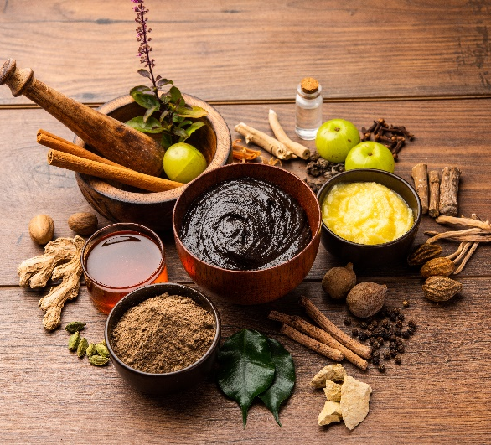
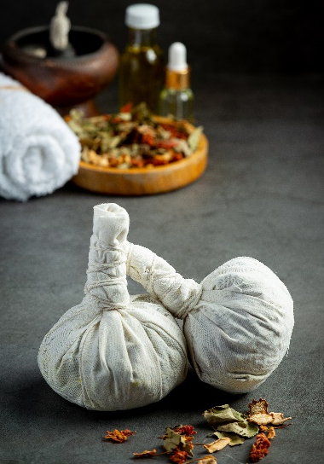
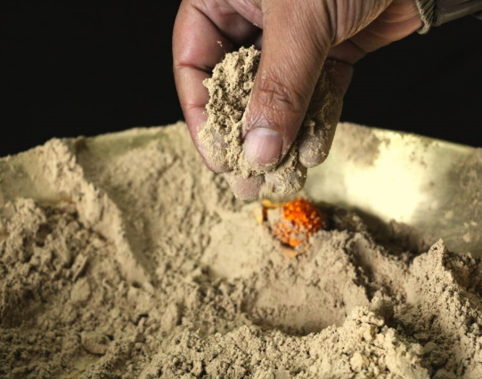
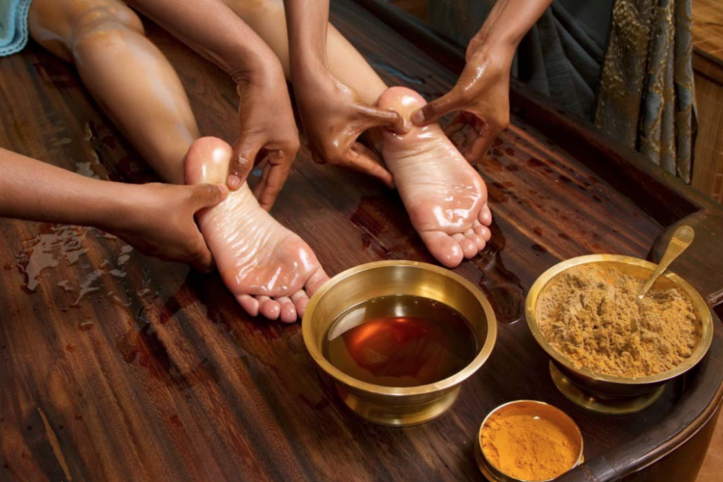
Treatment of Ama – Ayurvedic Cleansing
Panchakarma –Removal of excess dosha and ama from body
Pachana (burning/cooking ama) with digestive herbs: ginger, garlic, lemons, guduchi, haritaki
Deepana (Increasing appetite) with herbs that stimulate agni: Ajwan, black pepper, pippali, guduchi
Snehana (Oleation) use of internal and external oleation with ghee, sesame, coconut oil
Swedana (Sudation) use of dry or wet heat to induce sweating
Shodhana (Elimination of toxins) by Panchakarma (5 actions) – vamana (emesis), virechana (purgation), vasti (enema), nasya (nasal application of herbs), rakta moksha (blood purification - leaches)
Rasayana (rejuvenation) herbs and food to help strengthen the body after cleansing.
Pathya Ahara (Suitable food) and herbal formulations according to the strength of the person.

Slide 35
Classifications of Food & Herbs
Dravya Guna Karma Shastra
(Science of Herbology)

Slide 36
Categories of Food and Herb Classification
Taste (rasa)
Initial taste: 6 types (sweet, sour, salty, pungent, bitter, astringent)
Qualities (guna)
10 pairs of contrasting qualities (heavy/light)
Energy / Potency (veerya)
Active principal of the substance - Heating/cooling
Post – Digestive Effect (vipaka)
Transformation from the initial to taste after digestion: 3 types (sweet, sour, pungent)
Action (karma)
Therapeutic action of the substance on different system (digestive, nervous, ext. )
Special Action (prabhava)
Substance has a unique effect that does not align with logic

Slide 37
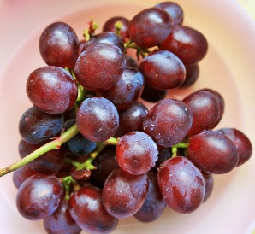
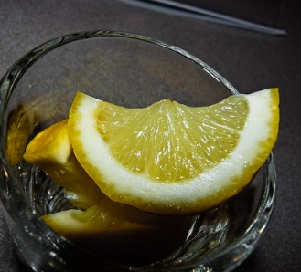
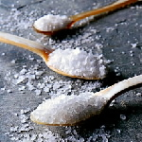
6 Tastes (rasa)
Sweet – complex carbohydrates, sweet fruits (mango, grapes, watermelon), grains, ghee,
milk, honey, root vegetables, sugar,
oils and meats
Sour – Yogurt, alcohol,
vinegar, cheese, lemon
Salty – Rock salt, sea salt,
gypsum, black salts
Pungent – Jalapenos, ginger,
black pepper, cloves, cayenne,
garlic, wasabi, horse radish
Astringent – Fruit peels,
unripe banana, pomegranate
peel, turmeric, goldenseal,
leafy greens, blueberries,
cranberries, beans, etc.
Bitter – Leafy green vegetables, neem, aloe, goldenseal, fenugreek, black tea, myrrh, bitter melon
Actions on the Mind:
Sweet - Compassion, satisfaction
In excess: Attachment, possessiveness
Sour - discrimination stimulation
In excess: Envy, jealousy, anger
Salty - Confidence, zest for life
In excess: Greed, over ambition
Pungent- Extroversion boldness
In excess: Anger, violence, hatred
Astringent – Introversion
In excess: Insecurity, fear
Bitter – Dissatisfaction, isolation
In excess: Grief, sorrow
Sweet
Earth + Water
Salty
Water + Fire
Pungent
Fire + Air
Astringent
Air + Earth
Bitter
Air + Ether
Sour
Earth + Fire

Slide 38
Sour (Earth + Fire) V- PK+
Hot in potency – cold to touch
Salty (Water + Fire) V- PK+
Penetrating and hot in potency
Sweet (Earth + Water) VP- K+
Builds and nourishes all tissues
Improves circulation and complexion
Mitigates poisons and strengthens heart
Relieves: thirst, heartburn
Increases breast milk
Excess: obesity, weak digestion, head ache, cough, worms
Stimulates acidic stomach secretions
Kindles hunger and helps digestion, reduces gas
Increases circulation and sharpens the senses
Excess: defects in vision, bleeding diseases, paleness, itching, severe thirst
Strengthens agni (deepana) and improves digestion (pachana)
Maintains proper electrolyte balance
Reduces stiffness, hardness and removes blockages
Calming to the nerves – relieves spasms
Excess: water retention, vitiates the blood, makes gray hairs, baldness, reduces strength and ojas
Pungent (Fire + Air) K- VP+
Astringent (Air + Earth) V- KP+
Bitter (Air + Space) PK- V+
Helps digestion and absorption, improves metabolism
Reduces congestion, relieves pain and muscle tension
Improves circulation, raises body temperature,
Promotes sweating, dries wounds, reduces excess fluids from the body
Excess: produces thirst, fainting, weakness of the body and semen, severe emaciation, burning sensations
Constricts blood vessels, stops bleeding and flow
Promotes healing
Constipating, drying
Excess: causes obstruction of tissue pores, stroke, convulsions, withholds gas, feces and urine
Helps anorexia, kindles hunger
Purifies blood, detoxifies body
Absorbs excess fat, oiliness, fluids
Opens up channels and purifies breast milk
Reduces body temperature and increases intelligence
Liver tonic
Excess: constipation, distension, causes vata diseases, depletes tissues
Cleanses mouth, kills worms
Improves skin texture

Slide 39
Herb, Spice & Food Classifications
Energy / Potency (Veerya)
Post – Digestive Effects (Vipaka)
1. Cooling - sweet, astringent, bitter VK↑ P↓ ex: aloe vera, chandana (sandalwood)
strengthens and tones tissues refreshes body
slows agni, reduces irritation and inflammation
inhibits bowel movements, inhibits sweating
increases urination, creates blockages in channels
2. Heating - sour, salty, pungent P↑ VK↓ ex: dry ginger, pippali
Improves circulation, kindles digestion, burns Ama
promotes sweating, depletes all dhatus (tissues),
dries stools and urine, causes dizziness, opens channels
taste on tongue may not be the same as after digestion
Taste on tongue | Taste after digestion
Sweet, Salty → | Sweet
Sour → | Sour
Astringent, Pungent → | Pungent
Special Action (Prabhava)
Beyond rational thinking, some herbs have a special action that does not follow the normal pattern
Ex: pomegranate – sour in taste, yet it does not increase Pitta

Slide 40
Herb, Spice & Food Classifications
Therapeutic Action on Body (Karma)
Deepana (stimulate herbs) – Stimulates agni, may or may not digests ama, increases appetite
herbs: Ajwan, black pepper, pippali, guduchi
Pachana (digestive herbs) – digests/cooks ama, may or may not strengthen agni
herbs: garlic, ginger, lemons, guduchi
Shamana (calms/reduces a dosha) – helps balance dosha by calming down the aggravated dosha
sesame oil = vatashamana, Ghee = pittashaman, Honey = kaphashamana
Shodana (purifies/removes dosha) – purifies and cleanses body, removes aggravated dosha from body
Vamana – upward, through the mouth Virechana – downward, through the rectum
herbs: vacha (calamus), avipathi, castor oil, haritaki
Grahani (solidifies stool) – increase appetite, improve digestion, absorb fluids, heating (causes stools to solidify)
herbs: dry ginger, musta, cumin
Anulomanan (Carminative, mild laxative) – corrects flow of vata, relieves gas, gastrointestinal pain, mild laxative, helps digest ama and eliminate it with stool
herbs: fennel, cardamom, coriander, warm milk, grapes – cooling ajwan, cumin, garlic – heating
Virechana (strong purgative) – promotes elimination of toxins from intestinal walls, forces bowel movement
herbs: castor oil, senna, avipathi

Slide 41
Dosha effect Taste (rasa) Energy after taste (vipaka)
VKP= P↓ bitter, astringent, pungent, sweet cooling sweet
Guna (qualities): heavy, unctuous (slimy), turbid (cloudy)
Actions: bitter tonic (especially liver and spleen), rejuvenative, alterative (cleanse and purify blood), purgative, antiviral, antitumor, immune enhancing, anti-inflammatory
Helpful in anemia, swollen glands, fever, reduces inflammation of liver and spleen
Dosha effect Taste (rasa) Energy after taste (vipaka)
VK↓P↑ sweet, bitter, astringent heating sweet
Guna (qualities): light, moist, unctuous (slimy)
Actions: tonic, rejuvenative, aphrodisiac, nervine, sedative, astringent, analgesic, antiaging
Rejuvenates the nervous system, clams and strengthens the nerves, promotes intelligence, helps with memory loss
Tonic for female reproductive system (especially excess bleeding and clots), can be useful for amenorrhea, dysmenorrhea, menopause, inflammatory vaginal conditions
Beneficial for skin: ulcers, eczema, mouth ulcers, acne. Wound healing: burns, scars, wounds, stretch marks
Juice can be used in loss of appetite, abdominal colic and worm infestations
Builds digestive fire (deepana) and burns ama (panchana), Laxative effect – irritates large intestine
Precaution: pregnancy
Increases sexual potency – helpful in infertility, increases sperm production, increases ojas, immunity, well-being
Used during stress, anxiety, nerve pain, muscle pain, promotes sleep, strengthens muscle tone, anti-inflammatory
Increase strength – good for old age, emancipation, over work, tissue deficiency, prevents wasting diseases
Benefits breathing: asthma, cough and allergic conditions stemming from low immunity
Precaution: high ama, sever congestion, low digestive fire
Preparation: decoction, mild decoction, powder (250 mg – 1 gm), medicated ghee, medicated oil (decoctions are easier to digest than straight powdered herb)
Aloe Vera
(Kumari)
Ashwagandha
(gives energy like a horse) Ashwa = horse; Gandha = smell

Slide 42
Dosha effect Taste (rasa) Energy after taste (vipaka)
VK↓P↑ bitter cooling pungent
Guna (qualities): Unctuous (slimy), moist, heavy, penetrating, sharp and subtle (effects the subtle channels)
Actions: strong Purgative (promoting evacuations by stool), laxative, anti-arthritic, antifungal, emollient (soothing, calming), oxytocic
Dosha effect Taste (rasa) Energy after taste (vipaka) VP↓K☺ astringent, bitter, sweet cooling sweet
Guna (qualities): light, flowing
Actions: sedative, nervine, rejuvenative, alterative, diuretic, cardio tonic, antispasmodic, anti-inflammatory
Nervous disorders, aids in recovery from exhaustion and stress, deficient nerve tissue (majja dhatu) epilepsy
Used for virechana in panchakarma – promotes purgation without cramping
Precautions: during pregnancy, intestinal obstruction, infection of internal organs, not for kids under 12 years old. Long term use can lead to dependency
Dosage: 1 tsp – 2 TBSP – depends on how easy the bowels are to move – be careful – can be a powerful purgative!
Helps with mild to moderate constipation, helps redirect the flow of vata downward, lubricates the large intestine
Lumps – external application can help reduce palpable lumps – apply with hot fomentation over breast, liver, abdomen for cysts, inflammation, tumors or lumps.
Good for external application to skin in case of dryness, eczema, when put in eyes helps with: styes, conjunctivitis
Mind tonic – helps revitalize nerve and brain cells, increases intelligence, memory, increases ability to learn, depression, drug addiction, gives strength to the mind, reduces dullness – calms and cools the mind, promotes sleep
Premature aging, hair loss, rasayana – strengthens all the dhatus (tissues) except for rakta (blood)
Chronic skin conditions (especially when related to stress) – Gotukola has a stronger effect on skin
Diuretic: reduces burning and pain while urinating
Helps with pain and inflammation
Brahmi is rare – Gotukola is often substituted (very similar properties)
Sattvic in nature – promotes a calm, spiritual outlook
Castor Oil
Eranda
Brahmi
Gotukola: very similar

Slide 43
Dosha effect Taste (rasa) Energy after taste (vipaka) VPK ↓ astringent, bitter heating sweet
Guna (qualities): light, dry, soft
Actions: deepana (increase appetite), ama pachana (burns toxins in all tissues), strengthening, rasayana, antiaging, antipyretic, immune tonic, anti-inflammatory, diuretic, nervine, anthelmintic (expels worms and internal parasites)
Dosha effect Taste (rasa) Energy after taste (vipaka) PK↓V↑ bitter cooling pungent
Guna (qualities): light, dry
Actions: bitter tonic, antipyretic – alleviate fevers, alterative, antiseptic, detoxicant, antibacterial, antifungal, antiprotozoal, destroys poisons, heals wounds
Useful in inflammatory skin conditions with itching, oozing, burning and infection: urticarial, eczema, ringworm, psoriasis. Helps with fevers from pitta with high ama, malaria, cough, nausea, vomiting
Useful in inflammatory skin conditions: urticarial, eczema, ringworm, psoriasis. Specific for burning sensations
all autoimmune disease causing inflammation, boost immunity
Liver protective – liver damage, viral hepatitis, poisoning from alcohol, chemicals or recreational and medicinal drugs
Powerful blood purifier and detoxifier good for liver
Oil is effective to treating external fungal and bacterial infections. Used as a mosquito repellant (dilution 2-5%)
Intestinal inflammation, hyperacidity, ulcers, colitis, Crohn’s disease, absorbs fluid from the colon, clears mucus and bleeding from GIT – fistulas, fissures, hemorrhoids, clears parasites from lower bowel, good for candida
Traditional used for toothache, gingivitis, and general oral hygiene. Infusion of leaves used for mouth wash
Clears pitta and kapha accumulations in the respiratory passages
Strengthens small intestine – diarrhea, vomiting, agnimandya (low digestive fire), pain in abdomen, parasite, GERD, liver diseases, anemia, Relieves chronic fever and bleeding conditions
↓ Pitta – burning in hands, feet and body, ↓ Vata – amavata (arthritis), chronic pain, spasms, ↓ Kapha – absorbs kleda (moisture) useful in premeha (diabetes)
Treats eye, urinary, respiratory, digestive diseases – primarily related to pitta
Guduchi
Tinospora cordifolia
Neem
Azadirachta indica

Slide 44
Dosha effect Taste (rasa) Energy after taste (vipaka) VPK ↓ sweet, astringent cooling sweet
Guna (qualities): light, dry, soft
Actions: deepana (increase appetite), astringent tonic, alterative, hemostatic, anthelmintic (removes parasites), refrigerant, stomachic, carminative, antacid
Dosha effect Taste (rasa) Energy after taste (vipaka) VP↓K↑ sweet, bitter cooling sweet
Guna (qualities): unctuous (slimy), heavy, moist, soft
Actions: Rasayana (nutritive rejuvenative, tonic, calming, cooling, aphrodisiac, diuretic, glactagogue (produces breast milk), inti-inflammatory, spermatogenic, immunomodulatory, antibacterial
Promotes the health of the female reproductive organs; infertility, debility, impotence, menopause, leucorrhea
Reduces blood pressure – strengthens heart, beneficial in treating cough, chronic fevers and lung abscess
Digestive disorders of high pitta: ulcers, hyperacidity, diarrhea and dysentery, Crohn’s disease, colitis
Preparation: decoction, milk decoction, powder (250 mg to 1 g), medicated ghee, medicated oil (decoctions are easier to digest than straight powder)
Increases breast milk: used to help lactating mothers, strengthens the uterus helps to prevent abortion, miscarriage
Precaution: high ama, excessive mucus
Helps increase sperm count and ovulation, strengthens ojas and enhances memory
Balances all 3 doshas, alleviates bleeding diseases, heart tonic, alleviates diarrhea
Juice has strong tonic properties for the blood – reduces pitta
Good for digestion, soothes an inflamed stomach and intestines, hyperacidity resulting in nausea
Rind is astringent – bind looses stools, kills parasites: tapeworms, pinworms and roundworms
Dry roasted seeds calm excessive appetite (sharp digestive fire)
Aphrodisiac – helps balance the female reproductive system
Beneficial during menopause – juice cools sensations of burning and flushing when taken regularly
Beneficial effect on Majja dhatu – nervous system, nourishes the brain and nerves
Pomegranate
Dādima
Shatavari
(woman of 100 husbands)

Slide 45
Traditional Ayurvedic Formulations
Amruthotharum Kwatham (decoction) VPK↓
Herbs: guduchi (8 parts), haritaki (4 parts), dry ginger (2 parts)
Actions: anti-arthritic, anti-gout, anti-inflammatory, antioxidant, antipyretic, antiviral, antibacterial, carminative, digestive stimulant, immunomodulatory, mild laxative
Indications:
Ama in deeper tissues – ama pachana - burns ama at all tissue layers
Agni deepana – kindles digestive fire
all types of fever
Common cold
Loss of appetite
Gas, flatulence or intestinal gas
Bloating, Abdominal distension
Mild Constipation
Rheumatoid Arthritis
Dosage: 1-2 tablets 2x/day before breakfast and dinner
Chyavanprash (lehyam – herbal jam)
VPK= (can be slightly heating if Pitta is high)
Herbs: Guduchi, bhumiamalaki, Vicar, Karchur, Cardamom, Musta, Punarnava, Vamsalochana, Gokshura, Kantakari, Vasa, Bilva, Raisin, Chadana, Pushkaramoola, Bala, Shatawari, Kesar, Cinnamon, Tamalapattra, Satapusa, Trikatu, Ashwagandha, Triphala, Honey, Sesame oil, Ghee, Jaggery, Amalaki
Taste: sweet, sour, pungent, bitter, astringent
Energy: heating After taste: sweet
Guna (qualities): heavy, unctuous (slimy)
Indications:
Rejuvenative to all tissues – increase resistance to infectious disease, builds hemoglobin and white blood cells.
Reproductive tonic – tonic in cases of debility, infertility, low libido, sexual weakness, increases ojas
Increase strength – facilitates the recover from stress and illness, increases muscle and tissue strength
Helps with cough and asthma, especially good for lungs – nourishes mucus membranes and helps to clear phlegm.
Precautions: high ama, hot weather for pitta individuals
Dosage: 1 tsp 1-2x/day after waking and/or before bed

Slide 46
Dhanyakadi Hima P↓
(cold coriander decoction)
Taste: bitter, pungent
Energy: cooling
After taste: pungent
Actions: alternative, diaphoretic, diuretic, carminative
Indications:
burning sensations, thirst/dry mouth
clears all channels
purifies the urinary channels
digestive aid, kindles digestion, burns ama
easy to make at home – just need coriander seeds and water
Ingredients:
1 Tablespoon Coriander seeds
1 cup water
Procedure:
Combine ingredients in a glass, earthen, or stainless steel container, cover and let sit overnight. Drink in the morning
Triphala KP↓ V↑ (drying nature)
(mixed powdered herbs or capsule)
Herbs: Haritaki, Bibhitaki, Amalaki (equal portions)
Taste: sweet, sour, pungent, bitter, astringent
Energy: cooling
After taste: sweet
Guna (qualities): light and dry
Actions: laxative, colon tonic, alterative, anti-inflammatory, carminative, expectorant, antioxidant, antimicrobial
Indications:
Obesity, good for eyes, clears the waste, relieves constipation, decoction can be used as an eye wash for eye infections, allergies – strain through very fine filter!
vata anulomana – corrects the directional flow of vata (laxative but may cause some bloating since it is drying)
improves taste, deepana (improves digestion), pachana (burns ama – toxins)
skin disorders
can be used as a rasayana (rejuvenative/tonic)
Dosage: ¼ - 1 tsp powder daily or 2 capsule 1-3x daily
Gandrahavahastadi Kwatham VK↓ P☺
(decoction)
Herbs: eranda (castor), putikaranja, citraka, shunthi (dry ginger), haritaki, punarnava, yavasa, bhumitala
Actions: corrects flow of vata - vata anulomana, increases strength of agni (digestive fire), diseases of vata origin
Indications:
Vāta disorders, indigestion, distaste, constipation, bloating, improves digestive capacity, improves appetite
Can be used for purgation in all Vāta disorders
Dosage: 1-2 tablets 2x/day before breakfast and dinner or before bed depending on need

Slide 47
Sitopaladi Churnam VKP= (mixed powdered herbs) - sweet cough powder
Herbs: Pippali (long pepper), Cinnamon, Vamsalochana (bamboo), Cardamom, Rock Sugar
Taste: sweet, pungent
Energy: heating
Guna (qualities): light, unctuous (slimy)
Actions: Expectorant, anti-asthmatic, antiallergenic, diaphoretic, bronchodilator
Indications:
cough, asthma, low digestive fire (agni mandya)
Useful in shortness of breath or asthma with wheezing from too much cold weather, bronchitis, chest congestion.
Sore throat, fever, muzzy head
Seasonal allergies, allergic rhinitis, allergies to dust, mold, airborne pathogens.
Helpful in sinus congestion, dull headache and runny nose
Dosage: ¼ to 1 tsp per day mixed equally with raw honey; lick frequently throughout day
Trikatu Churnam VK↓ P↑
(mixed powdered herbs)
Herbs: Shunthi (dry ginger), Maricha (black pepper), Pippali (long pepper)
Taste: pungent
Energy: heating
After taste: pungent
Guna (qualities): light, dry
Actions: carminative, appetizer, digestive, expectorant, bronchodilator, diaphoretic
Indications:
Digestive problems, weight loss, cough, asthma
Actions: deepana (increases digestive strength), ama pachana (burns ama – digests toxins)
Alleviates cough and asthma, acute allergic rhinitis, sinus congestion – benefits breathing
Clears orifices of the head, muzzy head, blocked ears, sore throats
Rejuvenative – especial to kapha and lungs
Alleviates nasal congestion
Dosage: 1/2-1 tsp with warm water or honey before food

Slide 48
Spice/Herb | Taste (rasa) | Energy | After Effect
Asafoetida / Hing VK↓ P↑ | Pungent | Heating | Pungent
Black Pepper VK↓ P↑ | Pungent | Hot | Pungent
Cardamom VK↓ P↑ | Sweet, pungent | Heating | Sweet
Cinnamon VK↓ P↑ | Pungent, sweet, astringent | Heating | Sweet
Clove VK↓ P↑ | Pungent, bitter | Heating/cooling | Sweet
Coriander VPK↓ | Astringent, bitter, pungent | Heating | Sweet
Cumin VPK = | Astringent, bitter | Cooling | Pungent
Fennel VPK↓ | Sweet, pungent | Cooling | Sweet
Fenugreek K↓ VP↑ | Bitter, pungent, sweet | Heating | Pungent
Garlic VK↓ P↑ | Pungent | Heating | Pungent
Ginger VK↓ P↑ | Pungent, sweet | Heating | Sweet
Mustard VK↓ P↑ | Pungent, bitter | Heating | Pungent
Saffron VPK↓ | Sweet, astringent | Heating | Sweet
Salt V↓ PK↑ | Salty | Heating | Pungent
Turmeric K↓ VP↑ | Pungent, bitter | Heating | Pungent

Slide 49
Asafoetida / Hing VK↓ P↑ | Black Pepper VK↓ P↑
• increase digestive fire, reduce gas, bloating, cramping • enhances taste, • cures colic, abdominal tumor, enlargement of abdomen, flatulence • worms • penetrating, aggravates pitta | • antioxidant and cleansing properties • very heating • enhances the flow of oxygen to the brain • enhances digestion and circulation of nutrients • stimulates the appetite • helps respiratory system, cough, cold, congestion, stagnation, worms
Cardamom VK↓ P↑ | Cinnamon VK↓ P↑
• expectorant, good for cough, colds, bronchitis, asthma • helps absorb nutrients, increases agni, reduces gas, bloating, cramping • antidotes caffeine in coffee/tea • burning urination, hemorrhoids | • enhance the bio availability of other herbs and spices • enhances and harmonizes circulation (vyana vayu) • good for colds, flu, cough, expectorant, sinus congestion • toothache and muscle tension • relieves gas, digestive stimulant • less aggravating to pitta than ginger (warming not hot)
Clove VK↓ P↑ | Coriander VPK↓
• digestive stimulant, gas, bloating, nausea, colic • good for colds, flu, congestion, sinus, bronchial • enhance circulation, digestion and metabolism • promotes oral hygiene and freshens the breath | • relieves gas, bloating, digestive stimulant, tonic • improves taste, water absorbent • mitigates: thirst, burning sensation, vomiting, difficulty • breathing, cough, emaciation, intestinal worms

Slide 50
Cumin VPK= | Fennel VPK↓
• slightly heating/pungent (balances all 3 doshas) • aids digestion, flushes toxins, drying, good for intelligence • purifies the uterus, cures fevers, aphrodisiac • bestows strength, improves taste, mitigates kapha • good for the eyes, cures diseases of vata • abdominal tumor, vomiting and diarrhea. | • Strengthen agni without aggravating pitta • tones the digestive system and enhances agni • dispel gas and alleviate cramping, helps with indigestion • calming on the nerves, and promotes mental awareness • promotes menstruation and milk flow for nursing mothers • roasted and eaten after meals to help digestion
Fenugreek K↓ VP↑ | Garlic VK↓ P↑
• diuretic, digestive stimulant, tonic • digestive aid, boils, cysts, lowers blood pressure • allergies, bronchitis, flu, toothache, arthritis • Increases milk flow and cleanses the milk • good for bones and promotes hair growth • good for the respiratory system | • colds, cough, congestion, asthma, heart disease, hypertension • cholesterol, palpitation, skin disease, parasitic infections • rheumatism, hemorrhoids, edema, impotence, hysteria • burns Ama, aches and pains, earache • tamastic in nature
Ginger (dry) VK↓ P↑ | Mustard VK↓ P↑
• enhances taste perception, digestive stimulant • easy to digest, aphrodisiac, removes gas, opens the respiratory system, expectorant, colic, vomiting, indigestion • flatulence, colds, cough, asthma, congestive conditions, arthritis, hemorrhoids, headaches, hear disease, burns Ama • fresh Ginger is harder to digest, penetrating, hotter | • digestive, alleviates stomach pains – gas, cramps • increases digestive fire, slightly drying • cures itching, leprosy, intestinal worms • antibacterial, ant inflammatory • can cause bleeding diseases – due to its hot potency

Slide 51
Cumin VPK= | Fennel VPK↓
• slightly heating/pungent (balances all 3 doshas) • aids digestion, flushes toxins, drying, good for intelligence • purifies the uterus, cures fevers, aphrodisiac • bestows strength, improves taste, mitigates kapha • good for the eyes, cures diseases of vata • abdominal tumor, vomiting and diarrhea. | • Strengthen agni without aggravating pitta • tones the digestive system and enhances agni • dispel gas and alleviate cramping, helps with indigestion • calming on the nerves, and promotes mental awareness • promotes menstruation and milk flow for nursing mothers • roasted and eaten after meals to help digestion
Fenugreek K↓ VP↑ | Garlic VK↓ P↑
• diuretic, digestive stimulant, tonic • digestive aid, boils, cysts, lowers blood pressure • allergies, bronchitis, flu, toothache, arthritis • Increases milk flow and cleanses the milk • good for bones and promotes hair growth • good for the respiratory system | • colds, cough, congestion, asthma, heart disease, hypertension • cholesterol, palpitation, skin disease, parasitic infections • rheumatism, hemorrhoids, edema, impotence, hysteria • burns Ama, aches and pains, earache • tamastic in nature
Ginger (dry) VK↓ P↑ | Mustard VK↓ P↑
• enhances taste perception, digestive stimulant • easy to digest, aphrodisiac, removes gas, opens the respiratory system, expectorant, colic, vomiting, indigestion • flatulence, colds, cough, asthma, congestive conditions, arthritis, hemorrhoids, headaches, hear disease, burns Ama • fresh Ginger is harder to digest, penetrating, hotter | • digestive, alleviates stomach pains – gas, cramps • increases digestive fire, slightly drying • cures itching, leprosy, intestinal worms • antibacterial, ant inflammatory • can cause bleeding diseases – due to its hot potency

Slide 52
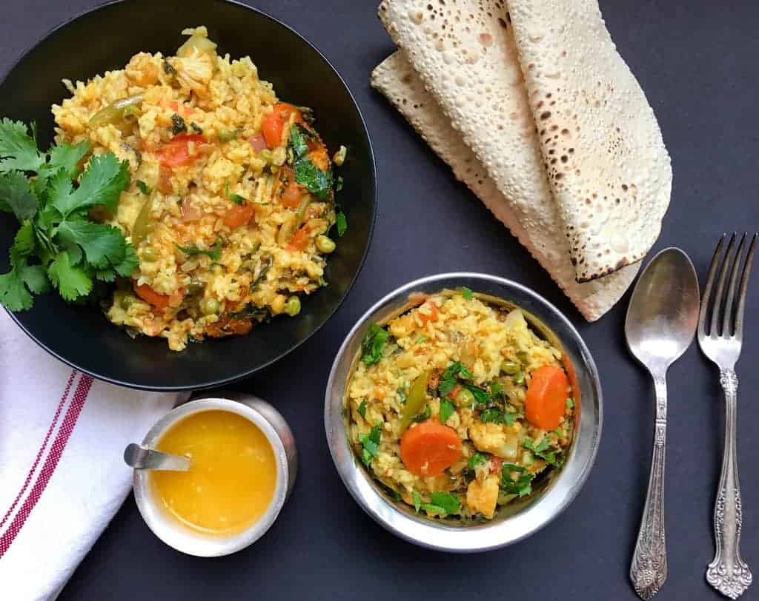
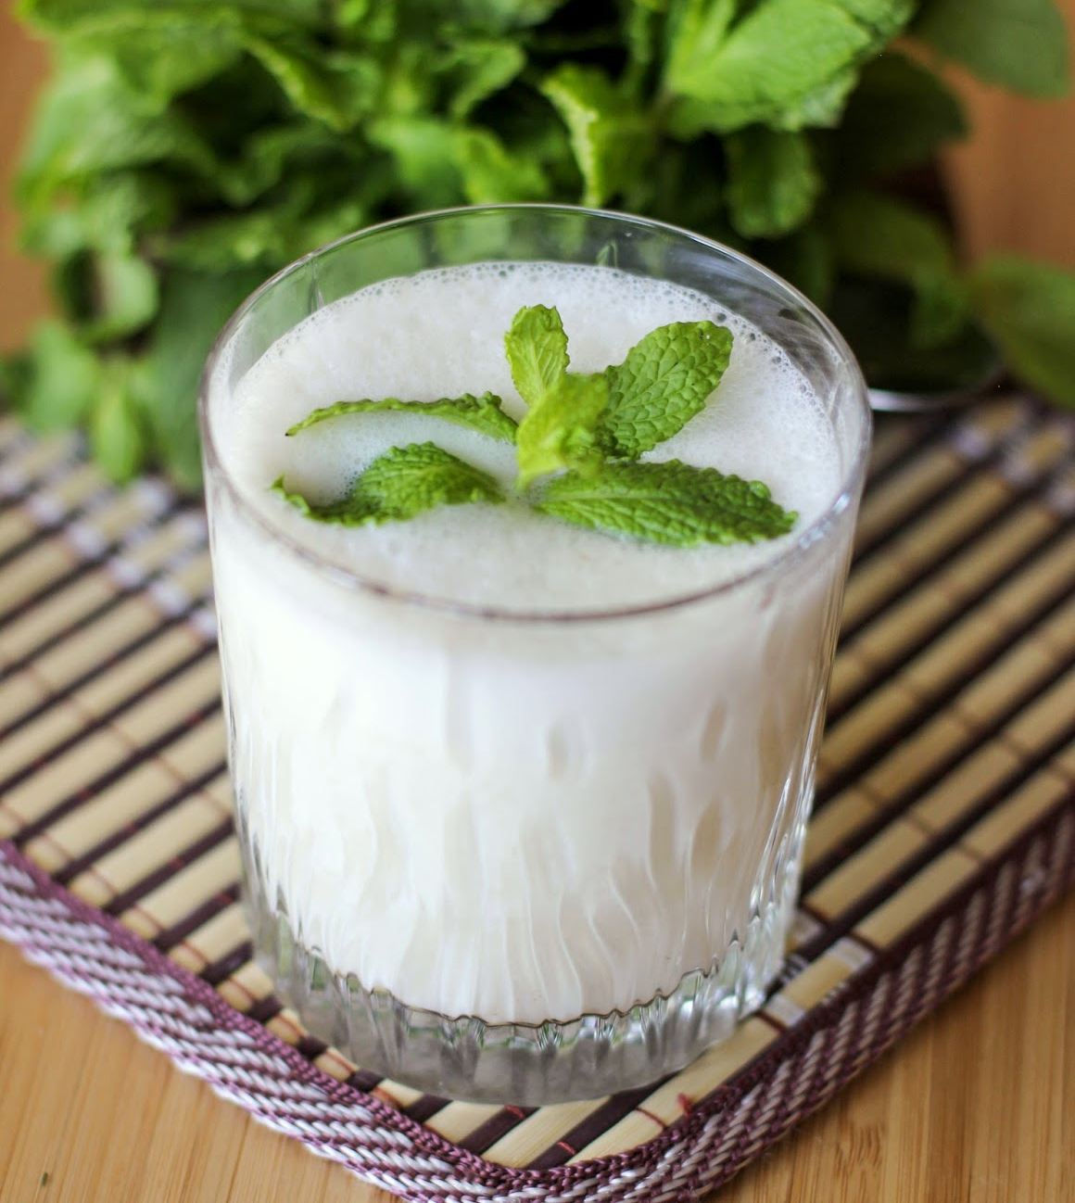
Ayurvedic Recipes:

